Slide 1
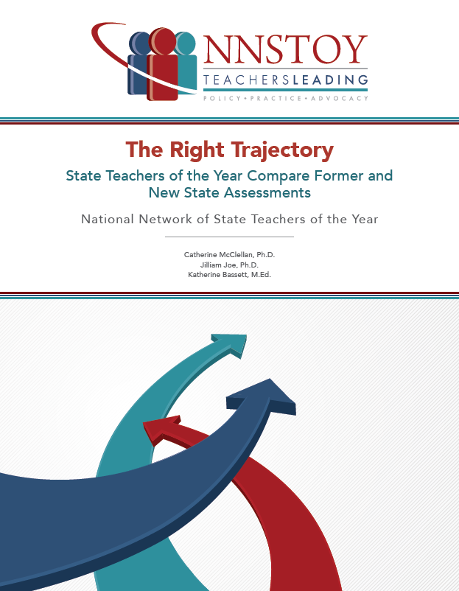
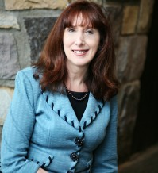
Highlights from The Right Trajectory State Teachers of the Year Compare Former and New State Assessments
Presented by Katherine Bassett,
NNSTOY Executive Director and CEO, NJ State Teacher of the Year 2000
katherine@nnstoy.org

Slide 2
New Jersey had a good test. Now it has an even better one.
In evaluating 6 assessments (4 prior state tests and PARCC and Smarter Balanced), participating teachers found that PARCC and Smarter Balanced represented a step forward in 5 dimensions:
Fuller range of reading and math knowledge and skills
Better cognitive complexity measures
Better alignment with and support for strong instructional practices
Information for a wider range of performers
Grade level appropriate

Slide 3
Methodology
11 State Teachers of the Year (STOY) and Finalists – including 3 NJ STOYs – reviewed the NJ ASK, PARCC*, and former Illinois summative assessments for 5th grade reading and math.
Each teacher spent at least 20 hours training, actually taking the tests, reviewing the tests for complexity, and sharing their analysis through a survey and a focus group discussion.
NNSTOY worked with psychometricians and policy partners throughout the process.
* Teachers only formally reviewed the PARCC "end-of-year" assessment, though they had access to the PARCC "performance-based" assessment. As a result, the report's findings do not fully take into account some PARCC elements, such as the extended response items that are intended to test students’ knowledge and skills more deeply.

Slide 4
PARCC better reflects the full range of cognitive complexity in a balanced way.
“This test strikes a balance between the number of items that require recall responses and responses that require higher-level cognitive skills."
"Items that require application of skills, such as graphing, categorizing, organizing, predicting, and estimating."
"Items that require students to demonstrate strategic and extended thinking skills, such as investigation, analysis, and design."
PARCC
54.6% agreed or strongly agreed
NJ ASK
45.4% agreed or strongly agreed
PARCC
54.5% answered "about right"
90.9% answered "about right"
NJ ASK
PARCC
NJ ASK
18.2% answered "about right"
54.5% answered "about right"

Slide 5
PARCC provides information relevant to a wider range of performers.
"Number of items that require application of skills needed to distinguish mid-performing from low-performing 5th grade students."
"Number of items that require complex thinking skills needed to distinguish high-performing from mid-performing 5th grade students."
PARCC
NJ ASK
63.3% answered "about right."
63.3% answered "about right."
PARCC
NJ ASK
18.2% answered "about right."
72.7% answered "about right."

Slide 6
Parting Thoughts
“I came with some preconceived ideas. PARCC was the boogeyman in my district – our whole district shut down in March because PARCC had come to town (you can’t touch computers, really high security, etc.). But looking at the actual form, I see that it’s a great test. In fact, I was surprised. I thought the rigor would be so high – but it was appropriate . . . I’ve spent 6 months grumbling about PARCC, but now I see that wasn’t warranted. We hadn’t seen the test – and media had stoked concerns from the public and parents. But that missed so much about what these tests are about.”
- NJ Teacher of the Year

