Slide 1


NJSBA 2016: Helping Boards Unlock Student Potential
Board of Directors
September 30, 2016
Dr. Lawrence S. Feinsod
Executive Director

Slide 2
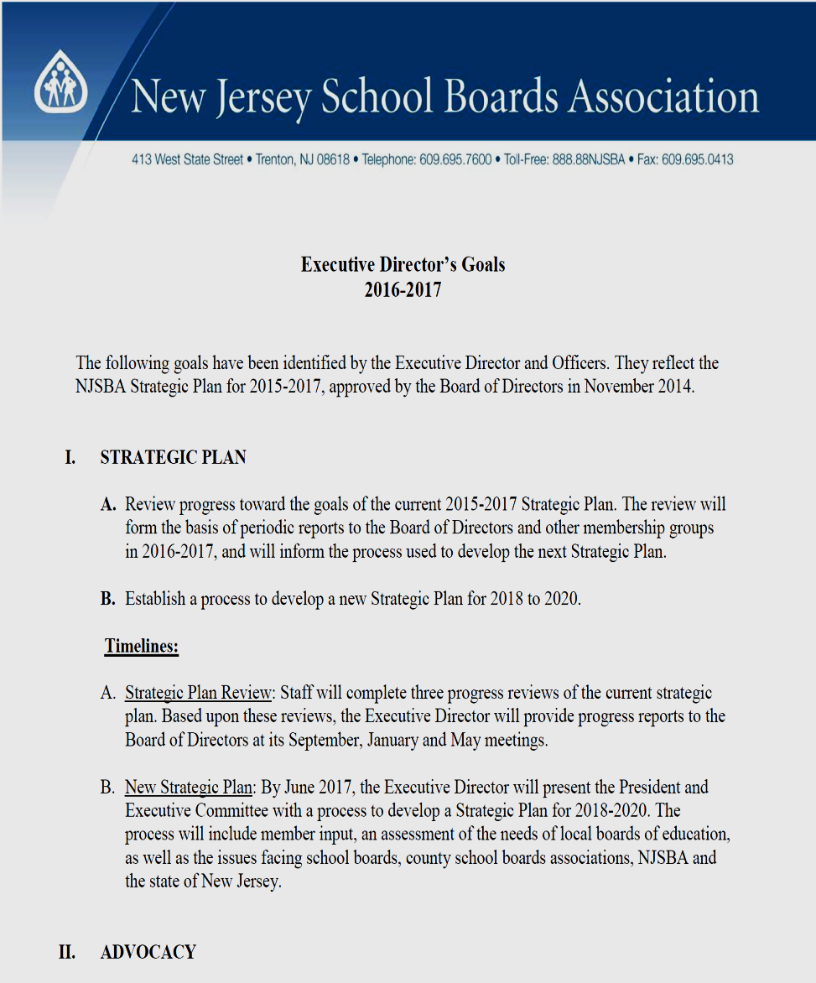
NJSBA 2016: Helping Boards Unlock Student Potential
Aligned with Strategic Plan
Advocacy
Leadership
Professional Development
Business Partnerships
Notes:
Your advance materials included a copy of the Executive Director’s Goals for 2016-2017. These goals are not only my goals, they set the direction for the entire Association. And they are aligned with our Strategic Plan, establishing new ground in advocacy; developing leadership at the state and county levels; and building partnerships that enable our members to secure the equipment and services they need for the 21st century classroom.
When the Officers and I developed these goals, we considered where we’ve been over the past two years—that is, since the implementation of the current Strategic Plan—and where we want to be when the plan concludes at the end of 2017.
In other words, we are building on our past success, which brings me to the first portion of my report.

Slide 3

NJSBA 2016: Helping Boards Unlock Student Potential
Donna Drewes
Co-Director
Sustainability Institute
The College of New Jersey
Notes:
One of NJSBA’s success stories involves sustainable practices…in the classroom, in the board room and in the business office. This success is most prominently reflected in Sustainable Jersey for Schools, our partnership with the Sustainability Institute at The College of New Jersey. The program will be just two years old next month. Yet, as of Wednesday of this week, 518 individual schools and 208 school districts—that’s 37 percent of the state’s operating districts—have joined Sustainable Jersey.
Donna Drewes, co-director of the program, is with us tonight to provide an update on the success of Sustainable Jersey for Schools.
[Donna will make her presentation. After she is finished, you will provide your progress report on the Strategic Plan.]

Slide 4

NJSBA Strategic Plan 2015-2017 x
Progress Report
September 30, 2016
Notes:
Two years ago, the Board of Directors adopted the 2015-2017 Strategic Plan, which contains 17 objectives, in four goal areas:
Student Achievement
Leadership and Advocacy
Effective Governance through Training and Direct Services, and
Finance
I have reported on the plan’s progress in the past. Tonight, I will highlight recent developments, initiatives and growth within context of the Strategic Plan.

Slide 5
Goal Area: Student Achievement
NJSBA will be THE leader in advancing student achievement to the highest levels through training and collaboration with other entities
Collaboration and Partnerships
U.S. Army
Rutgers School of Management and Labor Relations
NJ Business & Industry Association | Garden State Coalition of Schools
The College of New Jersey | NJ Charter Schools Association
NJ State League of Municipalities | Commission on Higher Education
Office of the Lieutenant Governor | NJ State Board of Education
NJ Department of Education | LEE Group
Governor’s Office | Legislative Leadership
Notes:
Student achievement should be at the foundation of everything we do. That’s the foundation of the Strategic Plan.
During my county association meetings, I have been presenting a video-and-discussion program on the board’s role in advancing achievement. So far, it has been presented in three counties; all of my visits this year will focus on advancing student achievement. Later, during our interactive session, I will share the video with you and ask what your board is doing, or can do, to advance teaching and learning.
Our Strategic Plan sets several objectives in advancing student achievement, including partnerships and collaboration.
Over the past two years, NJSBA has built relationships with a wide range of organizations—within the education community, in higher education, and in the business and non-profit sectors. This slide lists some of them. And in previous reports, I’ve spoken about the importance of these relationships. Tonight, I will highlight two of these relationships.

Slide 6
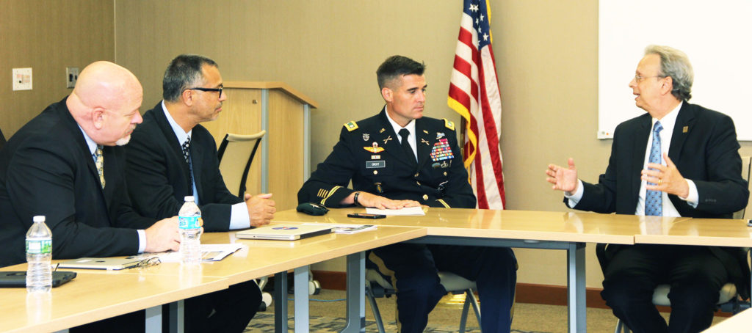
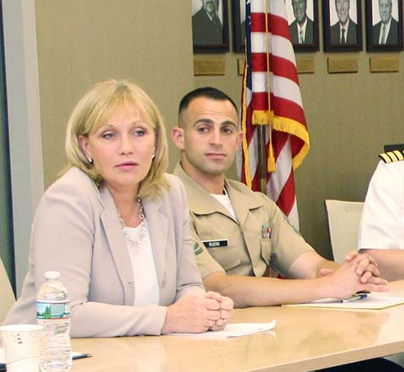
Goal Area: Student Achievement
Collaborate with all entities involved in the advancement of public education.
U.S. Army
iSTEAM Education
Military Opportunities Day
Workshop 2016 Platinum Sponsor
Lt. Gov. Kim Guadagno
Lt. Col. Edward Croot, Commander
Mid-Atlantic Recruiting Battalion
Notes:
We have established a valuable—and to use the words of our immediate past president, John Bulina—a “symbiotic” relationship with the United States Army. As you know, the Army has placed a STEAM education specialist, Sergeant First Class George Johnson, on our staff to assist in providing services to school boards on integrating STEAM education into all aspects of the school program. He has worked with John Henry, our STEAM education specialist, in consulting with school districts on policy and programs.
The Army is also sponsoring the iSTEAM Command Center on the Workshop Exhibit Floor—to the tune of $20,000. And it is coordinating the STEAM Tank competition at Workshop, which will involve public school students throughout the state.
Our relationship with the U.S. Army has made us aware of the post-secondary education and career opportunities available through military service. But we also recognize that some public high schools have been reluctant to give representatives of the armed services the same exposure as colleges and universities.
Here are some facts you may not be aware of: The U.S. Army is the largest provider of college scholarships in the nation; entry into the military is highly competitive; and the Army has more positions involving science, technology, engineering and mathematics than do many national corporations.
During the summer, NJSBA spearheaded an effort to encourage schools to schedule Military Opportunities Days this fall, so that students could learn what the various branches of service can offer. Each executive director of the state’s major educational organizations signed a letter that was sent to superintendents, school board presidents and principals requesting that they schedule a Military Opportunities Day. Lieutenant Governor Kim Guadagno is supporting the effort, and she participated in a planning meeting at NJSBA headquarters in June. In addition, the governor issued a proclamation declaring September as Military Opportunities Month.
I realize many schools may not want to include the military in events, such as college nights. That’s their right, and we’re not asking anyone to give it up. However, we also believe that it’s important for students to learn about the opportunities available through the various branches of service.
Lt. Col. Edward Croot, the commander of the Army’s Mid-Atlantic Recruiting Battalion, has been a key partner in building this relationship. He is an impressive young man and, by the way, a graduate of New Jersey’s public schools. Next Wednesday, at the invitation of State Board of Education President Mark Biedron, Col. Croot and I will address the State Board on the subject of military opportunities for students.

Slide 7

Goal Area: Student Achievement
Collaborate with all entities involved in the advancement of public education.
New Jersey Management-Labor Collaborative Project
Research: Positive Impact of Management-Labor Collaboration on Student Achievement
Second Cohort of Pilot Study
NJSBA, NJEA, NJASA, NJPTA, AFTNJ
$113,659 Grant from Federal Mediation and Conciliation Service
Notes:
Advancing student achievement requires thinking outside the box. NJSBA has been involved in a collaborative project with school district labor and management organizations. The program is based on the research of Dr. Saul Rubinstein of Rutgers University. It’s goal is to validate the impact of positive management-labor relations on teaching and learning in New Jersey’s public schools. The project is now entering its second stage.
NJSBA took the lead in coordinating this project with Dr. Rubinstein. Participants include the NJEA and AFT from labor; and the New Jersey Association of School Administrators and New Jersey Principals and Supervisors Association from the administrative side.
And I am happy to announce that, this past Monday, the project was awarded a $113,000 grant from the Federal Mediation and Conciliation Service, which is dedicated to building productive relationships through joint problem-solving and constructive activities.
The project has also received attention beyond the borders of New Jersey and the United States. On October 17, a delegation of school officials from South Africa will attend a one-day program about the program. It will take place at Rutgers.
Vincent DeLucia, NJSBA’s educator-in-residence, has been instrumental in developing and coordinating this project.

Slide 8

Goal Area: Effective Governance through Training and Direct Services
N.J. board members will be the best trained in the U.S.
Resource on Effective Board Membership (2016)
Ethics
Policy Development
Collective Bargaining
Curriculum
Finance
Student Achievement
Special Education
Advocacy
Notes:
The Strategic Plan addresses board member development and, specifically, calls for development of a printed resource on effective board membership. Earlier this year, we met that objective with the publication of Fundamentals of school Board Membership, which provides expert information from our staff on a wide range of subjects, from ethics and the board-superintendent relationship to the board’s role in advancing student achievement. The book is available to all members free of charge through our website.

Slide 9
Goal Area: Effective Governance through Training and Direct Services
N.J. board members will be the best trained in the U.S.
Ensure the Relevancy of Training
School Security and Student Safety (June 3)
Fundamentals of School Law (June 23)
Technology Conference (March 3)
Charter School Bootcamp (April 12)
Health Care Summit (September 28)
Notes:
NJSBA has made training more relevant with improvements to the New Board Member Orientation, and other mandated training. We’ve added new programs, such as our very successful School Security and Student Safety Conference, and improved existing ones, such as the annual Technology Conference, to ensure their relevancy.
But the relevancy of our training is not confined to statewide conferences; it also is reflected in our direct services.
As I reported in my last Strategic Plan update, we have expanded our field services program to meet the needs of our members.
That’s important for our members, and it is a tribute to the fact that the expertise of our field service staff is recognized beyond the Association. As an example, last week, we were asked to present a special program on the Ethics Act to a South Jersey school board. The request resulted from a recommendation by the Department of Education’s Office of Fiscal Accountability.

Slide 10
Goal Area: Effective Governance through Training and Direct Services
N.J. board members will be the best trained in the U.S.
Motivate Current and Prospective Board Members
to Attend Training
Regional Candidates Briefings (reinstituted)
North (September 27)
Central (October 4)
South (October 5)
3Rs (“Relationships, Responsibilities, Resources”)
South (November 29)
Central (December 6)
North (December 8)
Notes:
To encourage professional development among board members, we reinstituted the in-person, regional Candidates Briefings programs three years ago. Today, these programs convey a critical message to new and prospective board members—that is, training is important.
Tuesday night’s briefing in Mountain Lakes was well attended. It gave the candidates an overview of board ethics and responsibilities. But it also provided an introduction to NJSBA, our services, the expertise of our staff and, in particular, the importance of training.
The move to November school board elections and the extended lame-duck period presents an opportunity to reach successful school board candidates before they take office. That’s why we follow up with programs for newly elected members in November and December. The program is called 3Rs, which stands for Relationships, Responsibilities and Resources. Tat includes working with the superintendent and fellow board members; the role and functions of the school boards; and sources of information and assistance, particularly NJSBA.

Slide 11

Goal Area: Leadership and Advocacy
NJSBA will become the statewide voice for committed community leaders who are invested in advocating for the achievement of all students.
Strengthening partnerships and building new ones
Supporting advocacy at the local and county levels
Becoming a resource on educational policy decisions
Notes:
One hundred two years ago, NJSBA was founded for the express purpose of giving local school board a seat at the table where education decisions are made. Since then, this responsibility has increased in importance. And, by necessity, it has taken on new dimensions in terms of building alliances and empowering board members to be advocates in their communities, in their legislative districts, and in Trenton and Washington.

Slide 12

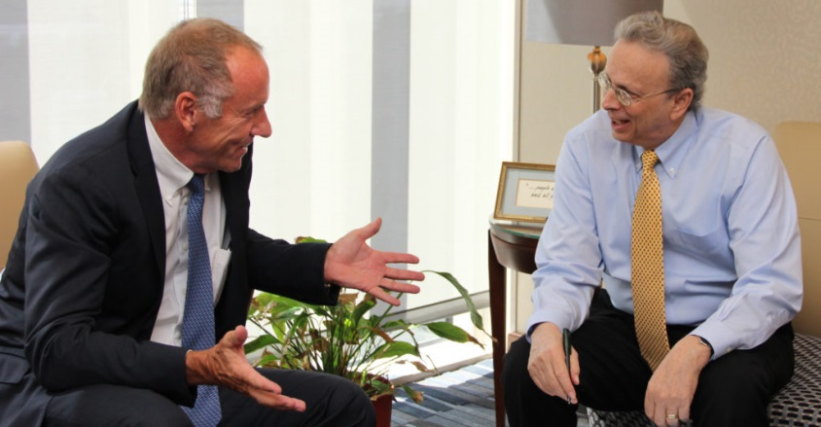
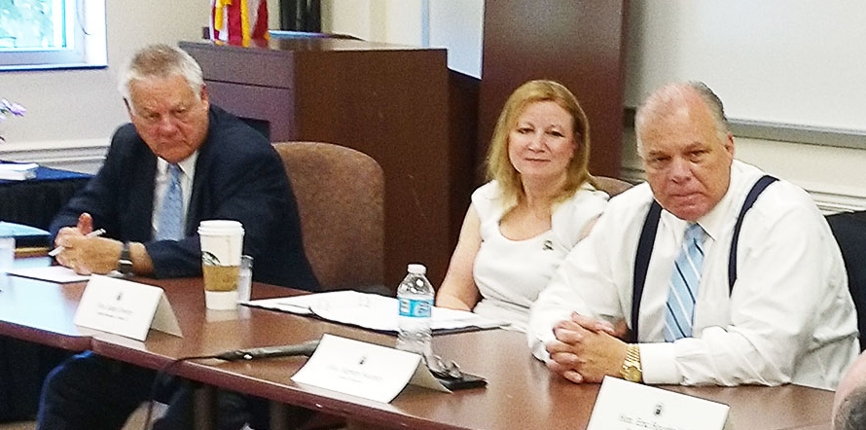
Goal Area: Leadership and Advocacy
Strengthen existing partnerships while developing new linkages that promote effective public education
Monthly meeting with State Board President Mark Biedron
Kim Harrington, Acting Commissioner, and outgoing Commissioner David Hespe
Meeting on school funding with Senate President Steve Sweeney
Notes:
On Monday, Kim Harrington will officially take over as Acting Commissioner of Education. Dave Hespe, who served as commissioner of education for two and a half years, has always been a very good friend of the New Jersey School Boards Association. He will certainly be missed.
We also have an excellent relationship with Kim Harrington. She has been serving as assistant commissioner and chief academic officer; she has lent her expertise to our programs at the county associations and Workshop. And she will do so again this year, during the “Conversation with the Commissioner” program at Workshop.
Building bridges is critical for our members.
State Board of Education President Mark Biedron, for example, makes it a point to meet with me each month to discuss educational issues. And we have talked about the issues, including school funding, the Accountability Regulations and the superintendent salary cap, which will sunset in November.
NJSBA also has a strong line of communication with the legislative leadership—on both sides of the aisle—including Senate President Steve Sweeney, who was the keynote speaker at our very successful Legislative Day program, held in June.
The Legislative Day is co-sponsored annually by the New Jersey PTA—an organization with 130,000 parent members. That’s another key partnership—and one that we value highly and nurture. And yes, the NJPTA leaders meet with Ray Pinney and me every month.

Slide 13
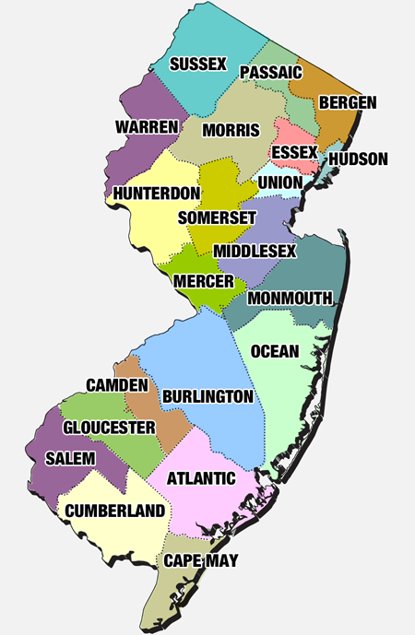


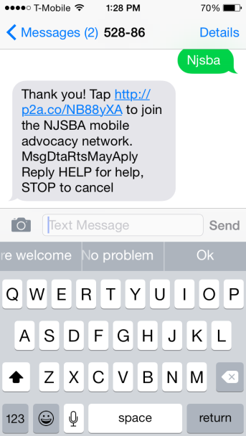
Goal Area: Leadership and Advocacy
Provide a framework that will support and advance advocacy at the local and county levels.
Monday Night Briefing for BOD, CAL and Legislative Committee
School Finance Presentations at County SBAs
Mobile Advocacy Network
Monday Night Briefing
Mobile Advocacy Platform
Critical in Lobbying for ESSA
Legislative District Meetings
County SBA Finance Program
Notes:
Providing the information, establishing lines of communication, and accessing lawmakers are focal points of the Strategic Plan.
How many of you tuned into the first Monday Night Briefing on September 12th? This is a new program, to be broadcast on the second Monday of each month. It is designed exclusively for members of the Board of Directors, County Association Leadership and Legislative Committee. Its purpose is to keep you informed of critical educational issues and developments affecting our Association and the membership. The first program looked at school funding. The next segment, which will be broadcast on October 10, will address the Accountability Regulations. If you are not able to listen to the program live, you can download it through a special link.
This fall, our staff is making presentations on school finance at several county school boards associations. We expect that more than 200 board members will hear the presentation in person. And we hope to summarize in a video series, to be produced after Workshop.
Development of our mobile advocacy platform is another effort directly linked to the Strategic Plan. We have used the tool judiciously and effectively. Last December, the platform was instrumental in our members’ efforts to advocate for enactment of the Every Student Succeeds Act, the federal elementary and secondary education law.

Slide 14
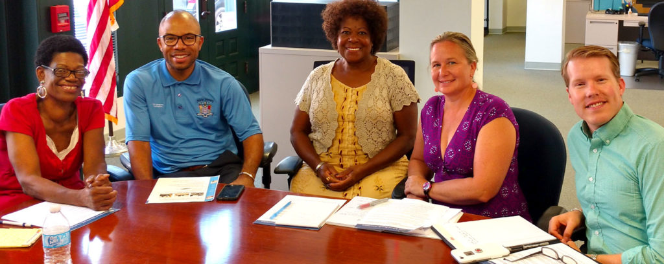
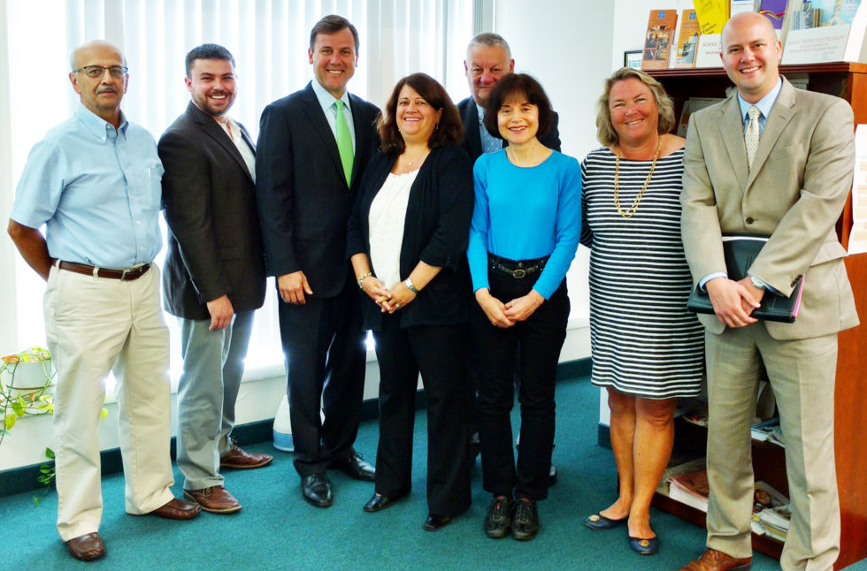
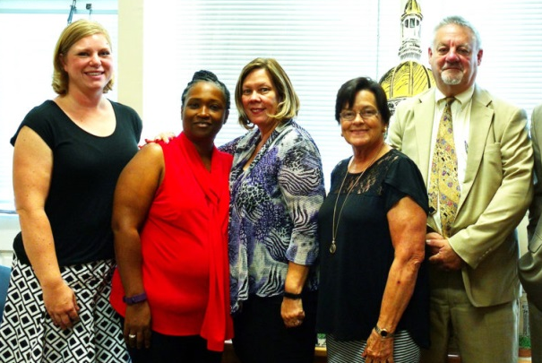
Goal Area: Leadership and Advocacy
Provide a framework that will support and advance advocacy at the local and county levels.
37 Legislative District Meetings
With Assemblyman Taliaferro (3rd LD)
With Senate GOP Leader Tom Kean, Jr.
With Sen. Cruz-Perez (5th LD)
Notes:
Still, nothing works as well as the personal touch. That’s why we stepped up the number of legislative district meetings over the summer. This year, local school board members in most of the state’s 40 legislative districts interacted, face to face, with their representatives.

Slide 15


Goal Area: Leadership and Advocacy
Become the “go to” resource during development and implementation of educational policy
September 6:
Response to Intervention Bill Signed into Law
September 8:
Governor Recommends Training for New Class of School Officers
Notes:
Another goal of the Strategic Plan is to make sure our knowledge and research are considered by state leaders when they make decisions that affect our schools, classrooms and students.
Recent developments reflect the positive impact we have had on public policy:
On September 6, Governor Christie signed a bill into law, creating a Response to Intervention initiative in the Department of Education. The new law reflects a recommendation of NJSBA’s Special Education Task Force, which spent over a year in research and deliberation.
In a September 7 presentation to the State Board of Education, the Department of Education’s Office of Special Education specifically references NJSBA’s report when describing its approach to Response to Intervention.
On September 8, Governor Christie conditionally vetoed legislation to create a new category of police officer, Class III, who could be assigned to schools. We supported the creation of the class of police officers, since it will give a lower-cost option for schools that desire a law enforcement presence. However, based on the research of our School Security Task Force, we also believed it is essential for such officers to receive formal training on working in the school environment. In his conditional veto message, the governor expressed our exact concern. So far, the Senate has concurred with the governor’s conditional veto; the bill is awaiting action in the Assembly.

Slide 16

Advocacy Update
September 30, 2016
Notes:
Before I continue with the last segment of the Strategic Plan update, on Finance, I’d like to ask Mike Vrancik, director of governmental relations to provide a brief report on legislative developments.
[Mike will provide an update.]

Slide 17
Goal Area: Finance
NJSBA will have stable and sustainable sources of funding to carry out its mission to provide training advocacy and support to advance public education through effective governance.
Enable Members to Secure Services and Equipment at Reduced Cost
NJSBA’s TEC
Grants Support
Increase Non-Dues Revenue
Build Public-Private Partnerships
Notes:
The Strategic Plan’s finance objectives include entering agreements to provide services and equipment to school districts at reduced costs. These efforts include the Grant Support program that helps school districts and their educational foundations access grant opportunities. We recently finalized our NJSBA TEC program—that stands for technology for education and career. It provides VMware cloud and disaster recovery services at discounted rates to our members.
Our financial goals also include increasing non-dues revenue and building public-private partnerships.

Slide 18
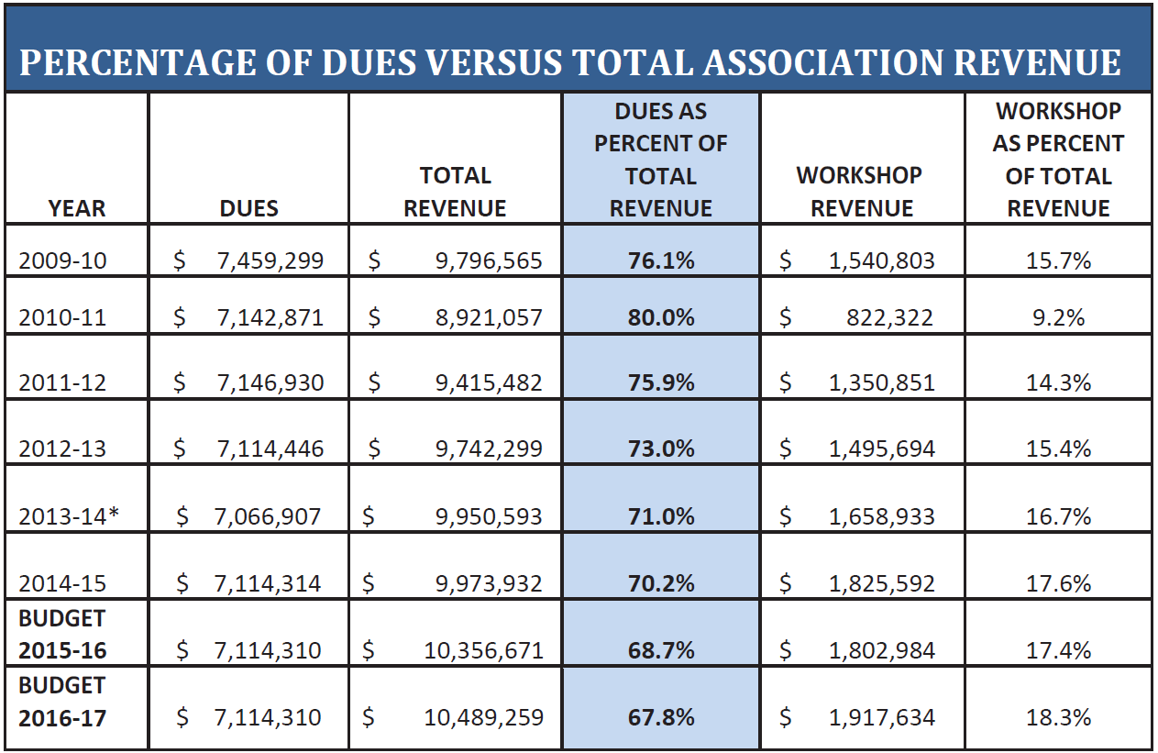
Goal Area: Finance
Increase non-dues revenue through the Educational Leadership Foundation of New Jersey and public-private partnerships
Notes:
The 2016-17 budget adopted by the Board of Directors increases non-dues revenue. As a result, membership dues account for less than 68 percent of the total budget. That’s directly in line with the goals of the Strategic Plan.
Let’s take a moment to focus on how we are getting there.

Slide 19

Goal Area: Finance
Increase non-dues revenue through the Educational Leadership Foundation of New Jersey and public-private partnerships
Funds All County School Boards Association Training Programs
ETS – fully funds March New Board Member Orientation
New Jersey Schools Insurance Group – fully funds January Orientation
Other contributors…NJM Insurance, Investors Bank, U.S. Army, Bristol-Myers Squibb, Verizon, Cooper Levenson
Notes:
The Educational Leadership Foundation of New Jersey, our non-profit fund-raising arm, plays a role in helping NJSBA to achieve this goal of the Strategic Plan.
On the screen, you will see the names of major contributors to ELFNJ.
For the past three years, ETS has fully funded one of our two weekend New Board Orientation Programs. I am happy to announce that earlier this month, the Executive Director of the ETS Center for Advocacy and Philanthropy gave final confirmation to Patty and me that they will again provide a $50,000 grant to ELFNJ to the orientation to be held at the Chauncey Center in March.
As you will recall in June, we received a $50,000 donation from the New Jersey School Insurance Group, which will fund the other weekend orientation program.

Slide 20

Goal Area: Finance
Increase non-dues revenue through the Educational Leadership Foundation of New Jersey and public-private partnerships
37 Corporate Partners
A 32% increase since last spring
Includes technology companies, law firms, architects, office equipment suppliers, and financial advisors
Supports NJSBA programming and the professional development of our members
Notes:
Our Corporate Partnership Program is growing and helping to support training and membership development. Last year, we set a goal of 25 corporate partners by June 2016. We exceeded that goal. Today, 37 companies are members of the program.

Slide 21
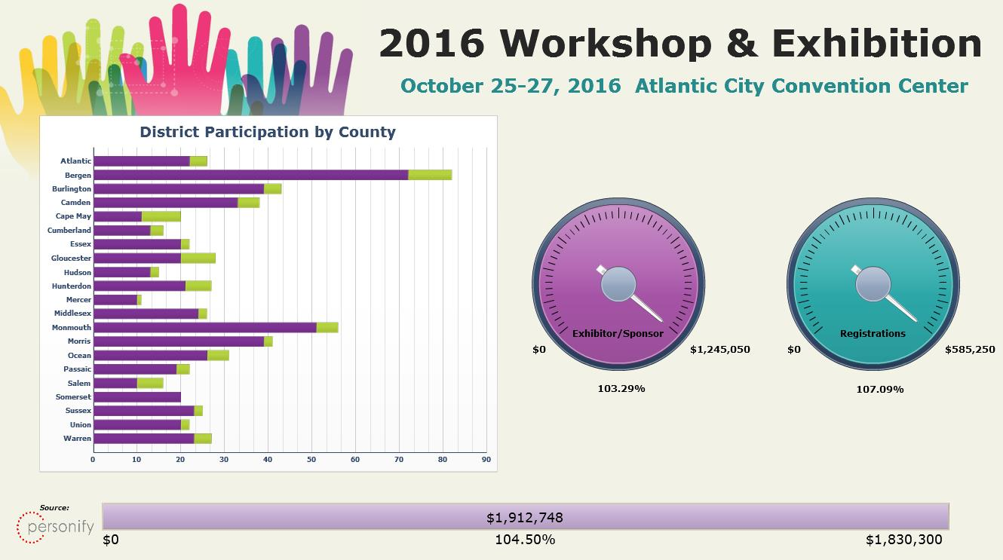
Goal Area: Finance
Increase non-dues revenue through the Educational Leadership Foundation of New Jersey and public-private partnerships
Notes:
The major non-dues revenue source is Workshop. When you came into the conference room tonight, you might have seen an image like this one on the video monitor in the back of the room. This is our Workshop dashboard, and it shows that we have already exceeded our Workshop 2016 financial goals—for both sponsorships/exhibits and registration.
Attendance is critical to attract vendors and sponsors. And we need the support of vendors and sponsors so that we can continue to offer the high-quality training and professional development to our members. Exceeding the financial goals for Workshop 2016 is a tribute to the hard work of our staff.

Slide 22
NJSBA 2016: Helping Boards Unlock Student Potential
Board of Directors
September 30, 2016
Dr. Lawrence S. Feinsod
Executive Director
Notes:
That makes a perfect segue to the final part of our report…the Workshop update…from our director of business development, Patty Maillet.
[After Patty completes her report, we will play the video presentation on student achievement.]

