Slide 1

District Annual Report
2014-2015
Donnie W. Evans, Ed.D.
New Jersey State Board of Education Meeting
February 10, 2016

Slide 2
Objectives
Provide contexts for work underway in PPS
  Challenges and obstacles
  Brighter Futures Vision, Mission, Goals & Objectives
Review district transformation objectives and initiatives for transforming the district
Review process & academic outcomes (past & present)
Review “Next Steps”
2

Slide 3
School Board
2014-2015
Dr. Jonathan Hodges, President
Mr. Kenneth Simmons, Vice President
Ms. Chrystal Cleaves
Mr. Christopher Irving
Mr. Errol S. Kerr
Mr. Manny Martinez
Dr. Lilisa Mimms
Mr. Flavio Rivera
Mr. Corey Teague
3

Slide 4
The District 2014-2015
Total Students 28,172*
PreK-12 (In District) 25,247
Pre-K (Private Providers) 2,925
Special Education 3,236
LEP 3,524
Free/Reduced Lunch 92%
Instructional Staff 2,650
Total Staff (inc. subs) 5,247
Total Schools 54
* 2014-2015 ASSA Report; does not include Adult High students
4

Slide 5
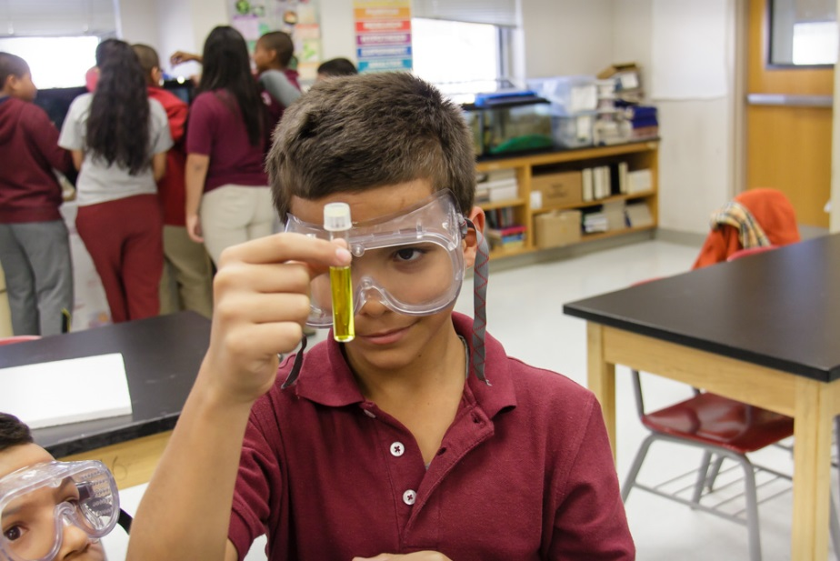
Challenges & Obstacles
Student Academic Outcomes
College Admission
  & Completion Rates
Internal & External
Communications
Attendance Rates
Facilities
Family & Community Engagement
5

Slide 6

“Life getting better for Paterson's poorest kids”
“The participation rate in Paterson's school breakfast program is now 93 percent,
tops among large, urban districts in New Jersey, according to the report.”
– The Star Ledger, NJ.com – 12/11/2015
6

Slide 7
The Strategic Plan
- Brighter Futures-
Vision
To be the leader in educating New Jersey’s urban youth
Mission
To prepare each student for success in the college/university of their choosing and in their chosen career
7

Slide 8
Brighter Futures: Core Beliefs
The core business of schools and the school district is teaching and learning which influences all decisions and activities in the district.
All children can achieve at high levels and it is the responsibility of educators to create environments where student learning can occur.
Effective instruction makes the most difference in student achievement.
All staff must be committed to “children first” and to the pursuit of high student achievement.
All schools must be safe, caring and orderly to enable teachers to teach and students to learn.
Only through collaboration with and engagement of community organizations, institutions, agencies, and families can the district realize its vision and mission.
8

Slide 9
District Priorities
Effective Academic Programs: Programs are research based and outcomes driven
Creating and Maintaining Healthy School Cultures: Schools are safe to enable teachers to teach and students to learn
Family and Community Engagement: District and school staff collaborate with and engage families and community institutions, organizations, and agencies
Efficient and Responsive Operations: Operations support the district and school’s core business and is responsive to the needs of staff, students, and community
9

Slide 10
Priority I: Effective Academic Programs
Goal 1: Increase academic achievement
Goal 2: Increase graduation rate
Goal 3: Increase college preparedness rate
Goal 4: Create student centered supports to ensure that all students are engaged in school
Goal 5: Provide technology to enable teaching and learning for the 21st Century
10

Slide 11
Priority II: Creating and Maintaining
Healthy School Cultures
Goal 1: Increase focus on the Paterson Effective Schools Model (PESM)
Goal 2: Reconfigure schools to increase student engagement
Goal 3: Expand School Choice options
Goal 4: Create/maintain clean and safe schools that meet 21st century learning standards
11

Slide 12
Priority III: Family and Community Engagement
Goal 1: Increase parent and family involvement by expanding and improving PTOs/PTAs
Goal 2: Create more Full Service Community Schools
Goal 3: Expand partnerships with community organizations, agencies, and institutions
Goal 4: Increase parent education opportunities to meet parents’ needs
12

Slide 13
Priority IV: Efficient and Responsive District-Level Operations
Goal 1: Improve internal and external communication
Goal 2: Strengthen customer service orientation in schools and district offices
Goal 3: Increase accountability for performance
Goal 4: Increase administrative and staff capacity
13

Slide 14
Transformation Objectives
Build healthy school cultures & climates
Efficient & responsive district operations
Implement teacher & administrator evaluation systems
Implement Common Core State Standards
Implement high impact academic interventions for low performing students
Strengthen the district’s assessment system
Build capacity among staff
  Teachers
  Principals & vice-principals
  District administrators & supervisors
14

Slide 15
District
Priority & Focus Schools
Focus Schools
School 2 School 18
School 3 School 20
School 5 School 21
School 8 School 24
School 11 School 25
School 12 School 26
Dr. Martin Luther King Jr.
New Roberto Clemente
EHS-Information Technology
EHS-Culinary Arts, Hospitality & Tourism
EHS-Government and Public Admin.
Academy High Schools
Priority Schools
School 6
School 10 (SIG)
School 13
School 15
School 28
Rev. Dr. Frank Napier Jr. (SIG)
15

Slide 16
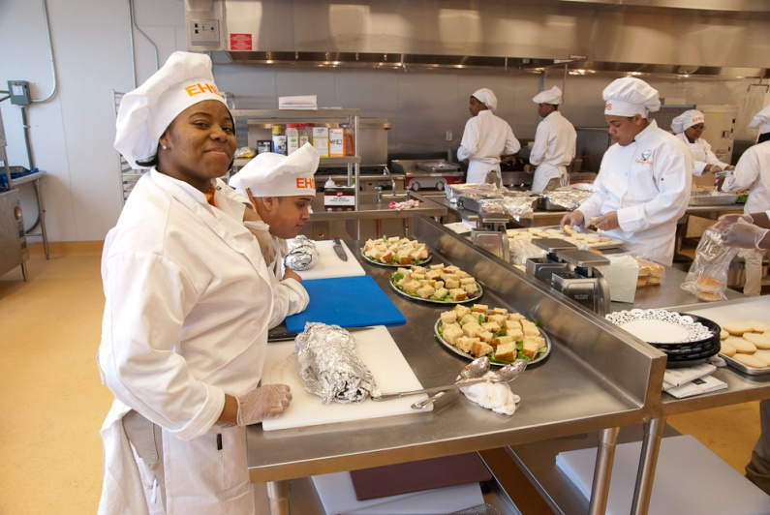
Accomplishments 2009-2014
Restructured and re-staffed comprehensive high schools into small autonomous thematic high schools
  Eastside Culinary Arts, Hospitality & Tourism
  Eastside Information Technology
  Eastside Government and Public Administration
  JFK Architecture & Construction Trades
  JFK Education and Training
  JFK Business, Technology, Marketing & Finance
  JFK Science, Technology, Engineering & Math
Converted all high schools to
“schools of choice”
Expanded Alternative High School capacity
Created first curriculum-based, student operated credit union
16

Slide 17
Accomplishments 2009-2014
Restructured & re-staffed lowest performing elementary schools
  Rev. Dr. Frank Napier, Jr. /School 4 (SIG)
  New Roberto Clemente Middle School (SIG)
  School 6 (SIG)
  School 10 (SIG)
  School 15
  Don Bosco Middle School
Implemented the Paterson Effective Schools Model to establish healthy school cultures
Completed process re-design of operational and instructional processes and procedures and realized $2 million annual savings in the following areas with the assistance of the American Productivity Quality Center (APQC):
  Finance Human Resources
  Academic Services Assessment
  Student Registration Student Information Services
  Facilities Benefits
Initiated pre-K through grade 3 literacy initiative
17

Slide 18
Accomplishments 2009-2014
Created five Full Service Community Schools (Schools 4, 5, 6, 15, & New Roberto Clemente)
Ended Social Promotion
Awarded local control of the “Operations” district performance review (DPR) area as a result of sustained high performance in this area
Auditor’s Management Reports (AMR) for 2012-2013, 2013-2014, & 2014-2015 indicated “no findings that rose to the level of reporting under government auditing standards”. Nor did we have any significant deficiencies in internal control
18

Slide 19
Percent of Students in Grades 3-8 Proficient and Above in NJASK Language Arts, Mathematics and Science
 | 2010 | 2011 | 2012 | 2013 | 2014
Language Arts Literacy
Total | 36.7% | 35.5% | 38.1% | 40.1% | 38.3%
General Education | 45.5% | 43.9% | 47.1% | 50.0% | 47.8%
Special Education | 10.2% | 7.8% | 10.8% | 11.9% | 10.8%
Limited English Proficient | 21.0% | 20.6% | 23.1% | 21.8% | 22.0%
Total Enrolled | 12,156 | 12,226 | 12,190 | 12,002 | 11,882
Valid Scale Scores | 11,897 | 11,997 | 11,999 | 11,791 | 11,636
Mathematics
Total | 45.9% | 49.2% | 51.0% | 52.0% | 53.1%
General Education | 54.4% | 58.2% | 60.2% | 62.4% | 63.1%
Special Education | 18.1% | 20.3% | 21.5% | 21.3% | 22.5%
Limited English Proficient | 36.3% | 37.8% | 40.1% | 38.3% | 41.5%
Total Enrolled | 12,156 | 12,226 | 12,190 | 12,002 | 11,882
Valid Scale Scores | 11,963 | 12,045 | 12,048 | 11,854 | 11,678
Science
Total | 65.3% | 58.7% | 63.9% | 61.2% | 60.5%
General Education | 76.3% | 69.2% | 74.5% | 72.6% | 72.7%
Special Education | 34.7% | 25.2% | 34.8% | 33.3% | 29.1%
Limited English Proficient | 49.2% | 41.8% | 47.2% | 43.2% | 43.0%
Total Enrolled | 4,023 | 4,090 | 4,029 | 3,995 | 3,910
Valid Scale Scores | 3,941 | 4,002 | 3,974 | 3,945 | 3,832
19

Slide 20
Accomplishments 2009-2014
The percentage of students in grades 3-8 performing at or above proficient in language arts increased from 35.5% in 2010-11 to 40.1% in 2012-13, from 49.1% to 52% in mathematics and from 58.7% to 61.2% in science
The total number of elementary students who obtained perfect math scores on NJASK continued to increase (up 124% since 2011), with 251 students receiving perfect scores on math and/or science in 2014
20

Slide 21
HSPA 2004-2014
Language Arts and Mathematics
Proficient and Above
Language Arts Literacy | 2004 | 2005 | 2006 | 2007 | 2008 | 2009 | 2010 | 2011 | 2012 | 2013 | 2014
TOTAL | 54.7% | 53.8% | 52.6% | 56.3% | 49.3% | 49.7% | 51.7% | 59.5% | 66.4% | 71.8% | 74.6%
GENERAL ED. | 70.6% | 70.4% | 69.3% | 74.0% | 65.7% | 72.3% | 69.9% | 76.0% | 80.% | 88.6% | 91.4%
SPECIAL ED. | 6.1% | 9.1% | 7.3% | 9.3% | 8.3% | 9.7% | 15.6% | 23.8% | 37.0% | 32.6% | 39.9%
LMTD. ENG. PROF. | 11.0% | 8.1% | 11.0% | 11.6% | 9.0% | 13.2% | 22.1% | 22.7% | 30.0% | 23.9% | 40.2%
MATHEMATICS | 2004 | 2005 | 2006 | 2007 | 2008 | 2009 | 2010 | 2011 | 2012 | 2013 | 2014
TOTAL | 40.4% | 47.2% | 45.5% | 39.7% | 34.2% | 31.9% | 33.0% | 30.9% | 46.6% | 49.7% | 43.2%
GENERAL ED. | 50.0% | 58.7% | 57.6% | 52.4% | 46.0% | 47.3% | 45.1% | 41.2% | 58.1% | 60.7% | 53.7%
SPECIAL ED. | 9.1% | 6.8% | 4.5% | 1.5% | 1.9% | 2.9% | 7.3% | 4.7% | 13.9% | 12.1% | 9.4%
LMTD. ENG. PROF. | 20.3% | 26.7% | 25.4% | 16.1% | 13.9% | 8.2% | 15.1% | 8.6% | 27.4% | 30.4% | 31.1%

Slide 22
Accomplishments 2009-2014
HSPA LAL scores increased from 49.7% proficient and above in 2009 to 74.6% in 2014 with 91.4% of general education students at or above proficient
HSPA mathematics scores have increased from 31.9% in 2009 to 43.2% in 2014 with 53.7% of general education students at or above proficient
The district’s graduation rate using the cohort method for the 2014 graduating class increased to 74.2% as compared to 45.6% in 2009
The total number of high school seniors who planned to attend a four year college increased 33% from 2010 to 2014
Rosa L. Parks School of Fine & Performing Arts, Academy of Health Science (HARP) and International High School achieved “Bronze” recognition for being among the best high schools in New Jersey (according to U.S. News and World Report)
22

Slide 23
Accomplishments 2009-2014
  Implemented a pay for performance provision for certificated instructional staff:
    teachers rated highly effective can move up two steps on the appropriate salary guide, thus accelerating reaching maximum steps
    teachers rated effective can move up one step on the appropriate salary guide;
    Teachers rated ineffective or partially effective receive no step increases and must improve to retain their positions
  Additional compensation for teachers who volunteer and are selected to teach in a district Turn-Around School
  Incentives for teachers joining the district to fill “hard to fill” positions in critical shortage subject areas
23

Slide 24
Accomplishments 2009-2014
Competitive Grants Awards – Over $35 million
Award year | Term | Title | Amount
2010 | 2010-2013 | School Improvement Grant – Schools 4 & 10 | $12,000,000.00
2014 | 2014-2017 | School Improvement Grant – Schools 6 & NRC | $12,000,000.00
2010 | 2010-2015 | US DOE Full Service Community Schools - Schools 5 & 4 | $ 2,300,000.00
2011 | 2011-2013 | Talent 21 grant to support technology initiatives | $ 2,200,000.00
2011 | 2011 | US Department of Health HRS/School Based Health Center | $ 500,000.00
2011 | 2011 & ongoing | USDA/NJDA Fresh Fruit & Vegetables Grant | $ 600,450.00 (through 2016)
2012 | 2012 | US Department of Health HRS/School Based Health Center | $ 500,000.00
2012 | 2012-2017 | 21st Century Learning Centers | $ 2,600,000.00
2013 | 2012-2017 | Race to The Top Phase III (Teacher and Principal Evaluation) | $ 1,290,000.00
2013 | 2013 | Lowe’s Community Improvement for School 4 | $ 100,000.00
2013 | 2013 | EE4NJ Pilot Program for Principal Evaluation System | $ 50,000.00
2013 | 2013 | Optimum Lightpath Grant for Panther High School & School 9 | $ 20,000.00
2014 | 2014-2017 | USDOE Turn-around School Leaders Program | $ 1,500,000.00
24

Slide 25
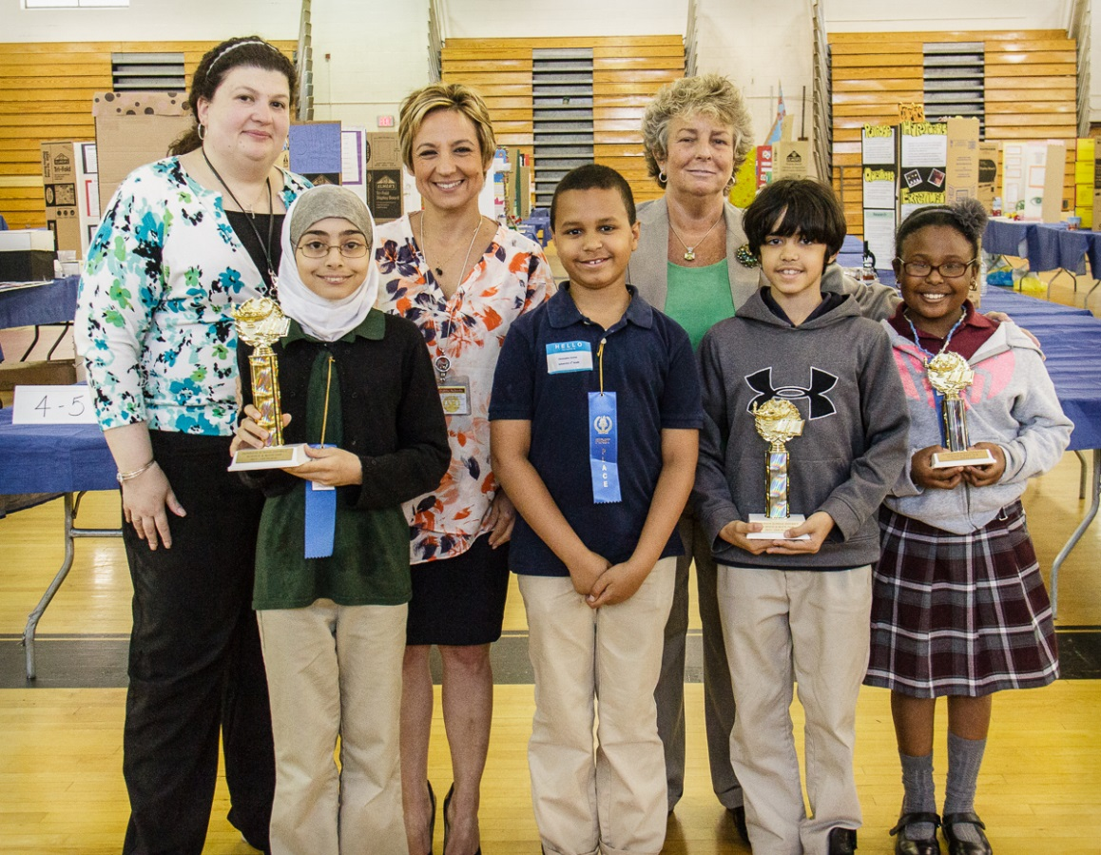
2014-2015
Objectives & Accomplishments
25

Slide 26
Transformation Objectives
2014-2015
Build healthy school cultures & climates
Efficient & responsive district operations
Implement teacher & administrator evaluation systems
Implement Common Core State Standards
Implement high impact academic interventions for low performing students
Strengthen the district’s assessment system
Build capacity among staff
  Teachers
  Principals & vice-principals
  District administrators & supervisors
26

Slide 27
2014-2015 Headlines
Four city schools have been named bronze award winners in the “Let’s Move Active Schools” program spurred by First Lady Michelle Obama’s fitness initiative – Paterson Press – 9/16/14
Paterson schools to create computer simulation of life as a principal – NJ.com - 10/2/14
Paterson school district looks to launch prestigious International academic program - NorthJersey.com – 2/9/15
The List: Which NJ Districts Do Best Job of Feeding Breakfast to Poor Children (features Paterson serving 93 % of students, or more than 23,000, “by far the largest number on the list”)– NJ Spotlight – 10/26/15
Paterson’s high school graduation rate reaches new high of 78.2-percent – Paterson Times - 12/4/15
School apps put important info at North Jersey parents’ fingertips (features Paterson as first to offer in 2013) – The Record – 12/10/15
27

Slide 28
District Transformation Initiatives
2014-2015
Comprehensive Assessment System | Common Core | Healthy School Culture | Capacity Building | Teacher/ Principal Evaluation | High Impact Interventions | Efficient & Responsive Operations
Star Math & ELA | Instructional Model | Effective Schools | Univ. of Pittsburgh IFL | Achieve NJ | Breakfast After the Bell | Cliff Planning
PARCC | DOE Model Curriculum | NJPBSIS | Pre K-3 Literacy Initiative | Leadership Institute | RAC | Five-year Facilities Plan
Unit Assessments | Arts Initiative | Elementary School Choice | Urban Schools Human Capital Academy |  | End Social Promotion | Strategic Planning
 | CTE Initiative | Family & Community Engagement Reformation | Strategic Data Project |  | Attendance Initiative | Technology Initiative
 |  |  | Special Education Restructuring |  | Graduation Enhancement | Transportation Restructuring
 |  |  | Guidance Restructuring |  |  | Facilities Restructuring
 |  |  | ELL Restructuring
28

Slide 29
Accomplishments 2014-2015
Status Report on Transformation Initiatives:
Instructional Model
Elementary School Choice – Single Gender, Dual Language, Fine & Performing Arts
Career & Technical Education (CTE) Initiative
Urban Schools Human Capital Academy
Strategic Data Project
Special Education Restructuring
Leadership Development Institute (Preparation of Leaders for Turn-around Schools’ Grant)
Facilities Planning - completed development of new 5 Year Long Range Facility Plan
Breakfast After the Bell
Technology Initiative - Seamless, first-time PARCC administration
Local Governance Initiative (QSAC)
29

Slide 30
Academic Outcomes
2014-2015
2015 PARCC data is a new “baseline” from which to progress from and measure against moving forward.
PARCC proficiency outcomes are not comparable to either NJASK or HSPA (‘apples to oranges’).
A child’s score may look lower this year because the tests measured more complex skills. The PARCC tests measure whether students are meeting new, higher academic standards and mastering the knowledge and skills they need to progress in their K-12 education and beyond.
Not possible to draw conclusions about change over time, i.e., how did we do compared to last year?
30

Slide 31
2015 PARCC English Language Arts/
Literacy (ELA)
 | Count of Valid Test Scores | Not Yet Meeting (Level 1) | Partially Meeting (Level 2) | Approached Expectation (Level 3) | Met Expectation (Level 4) | Exceeded Expectation (Level 5) | % >= Level 3 | % >= Level 4
ELA03 | 1988 | 32% | 29% | 23% | 15% | 1% | 39% | 16%
ELA04 | 1813 | 19% | 28% | 32% | 19% | 2% | 53% | 21%
ELA05 | 1713 | 18% | 28% | 30% | 24% | 1% | 55% | 25%
ELA06 | 1665 | 18% | 26% | 33% | 21% | 2% | 56% | 23%
ELA07 | 1703 | 22% | 19% | 27% | 25% | 7% | 59% | 32%
ELA08 | 1699 | 23% | 21% | 26% | 26% | 4% | 56% | 30%
ELA09 | 1061 | 44% | 24% | 20% | 11% | 0% | 31% | 11%
ELA10 | 1106 | 55% | 22% | 14% | 9% | 0% | 23% | 9%
ELA11 | 972 | 42% | 28% | 20% | 10% | 1% | 31% | 11%
31

Slide 32
2015 PARCC Mathematics
 | Count of Valid Test Scores | Not Yet Meeting (Level 1) | Partially Meeting (Level 2) | Approached Expectation (Level 3) | Met Expectation (Level 4) | Exceeded Expectation (Level 5) | % >= Level 3 | % >= Level 4
MATH03 | 2028 | 16% | 31% | 32% | 19% | 2% | 53% | 21%
MATH04 | 1867 | 15% | 36% | 30% | 18% | 1% | 49% | 19%
MATH05 | 1772 | 12% | 33% | 34% | 19% | 1% | 54% | 20%
MATH06 | 1724 | 16% | 37% | 30% | 16% | 1% | 47% | 17%
MATH07 | 1748 | 15% | 37% | 31% | 17% | 1% | 49% | 18%
MATH08 | 1495 | 34% | 33% | 22% | 10% | 0% | 32% | 10%
ALG01 | 1494 | 25% | 37% | 22% | 15% | 1% | 38% | 16%
GEO | 1096 | 31% | 55% | 12% | 1% | 0% | 13% | 1%
ALG02 | 820 | 70% | 24% | 5% | 1% | 0% | 6% | 1%
32

Slide 33
“Top PARCC Scores in Passaic County”
(NJ.com- February 3, 2016)
PASSAIC COUNTY MATH
  Third grade, school: Paterson, School 28, 76.9%
  Fourth grade, school: Paterson, School 28, 23.1%
  Fifth grade, school: Paterson, School 28, 46.7%
  Sixth grade, school: Paterson, School 28, 40.5%
PASSAIC COUNTY LANGUAGE ARTS
Third grade, school: Paterson, School 28, 23.1%
Sixth grade, school: Paterson, School 28, 35.1%
Seventh grade, school: Paterson, School 28, 61.2%
Eighth grade, school: Paterson, School 28, 40.6%

Slide 34
Percent of Students in Grades 3-8 Proficient and Above in NJASK Language Arts, Mathematics and Science
 | 2010 | 2011 | 2012 | 2013 | 2014 | 2015
Language Arts Literacy
Total | 36.7% | 35.5% | 38.1% | 40.1% | 38.3% | N/A
General Education | 45.5% | 43.9% | 47.1% | 50.0% | 47.8% | N/A
Special Education | 10.2% | 7.8% | 10.8% | 11.9% | 10.8% | N/A
Limited English Proficient | 21.0% | 20.6% | 23.1% | 21.8% | 22.0% | N/A
Total Enrolled | 12,156 | 12,226 | 12,190 | 12,002 | 11,882 | N/A
Valid Scale Scores | 11,897 | 11,997 | 11,999 | 11,791 | 11,636 | N/A
Mathematics
Total | 45.9% | 49.2% | 51.0% | 52.0% | 53.1% | N/A
General Education | 54.4% | 58.2% | 60.2% | 62.4% | 63.1% | N/A
Special Education | 18.1% | 20.3% | 21.5% | 21.3% | 22.5% | N/A
Limited English Proficient | 36.3% | 37.8% | 40.1% | 38.3% | 41.5% | N/A
Total Enrolled | 12,156 | 12,226 | 12,190 | 12,002 | 11,882 | N/A
Valid Scale Scores | 11,963 | 12,045 | 12,048 | 11,854 | 11,678 | N/A
Science
Total | 65.3% | 58.7% | 63.9% | 61.2% | 60.5% | 62.4%
General Education | 76.3% | 69.2% | 74.5% | 72.6% | 72.7% | 72.5%
Special Education | 34.7% | 25.2% | 34.8% | 33.3% | 29.1% | 32.5%
Limited English Proficient | 49.2% | 41.8% | 47.2% | 43.2% | 43.0% | 46.7%
Total Enrolled | 4,023 | 4,090 | 4,029 | 3,995 | 3,910 | 4,065
Valid Scale Scores | 3,941 | 4,002 | 3,974 | 3,945 | 3,832 | 3,929
34

Slide 35
High School Renewal Results
Paterson Public Schools Graduation/Dropout Rate
Graduation Year | Total Students | Graduated |  | Dropouts |  | Transfers |  | Other
 |  | # | % | # | % | # | % | # | %
2009 | 2112 | 964 | 45.60 | 435 | 20.60 | 470 | 22.25 | 243 | 11.50
2010 | 1960 | 987 | 50.36 | 350 | 17.86 | 400 | 20.41 | 223 | 11.38
2011 | 1377 | 881 | 64.0% | 86 | 6.2% | 56 | 4.1% | 354 | 24.5%
2012 | 1466 | 974 | 66.4% | 140 | 9.5% | 95 | 6.5% | 257 | 17.5%
2013 | 1537 | 1109 | 71.9% | 166 | 10.8% | 97 | 6.3% | 166 | 10.8%
2014 | 1542 | 1149 | 74.2% | 164 | 10.6% | 87 | 5.6% | 142 | 9.2%
2015 | 1596 | 1249 | 78.2% | 162 | 10.2% | 94 | 5.9% | 91 | 5.7%
35

Slide 36
High School Renewal Results
Graduation Rate
Year | 2009 | 2010 | 2011 | 2012 | 2013 | 2014 | 2015
Percentage | 45.6% | 50.4% | 64.0% | 66.4% | 71.9% | 74.2% | 78.2%
Gains (+/-) +4.8 +13.6 +2.4 +5.5 +2.3 +4.0

Slide 37
100% Graduation Rate
Academy of Health Science (HARP)
Rosa L. Parks School of Fine & Performing Arts – for 2 consecutive years

Slide 38
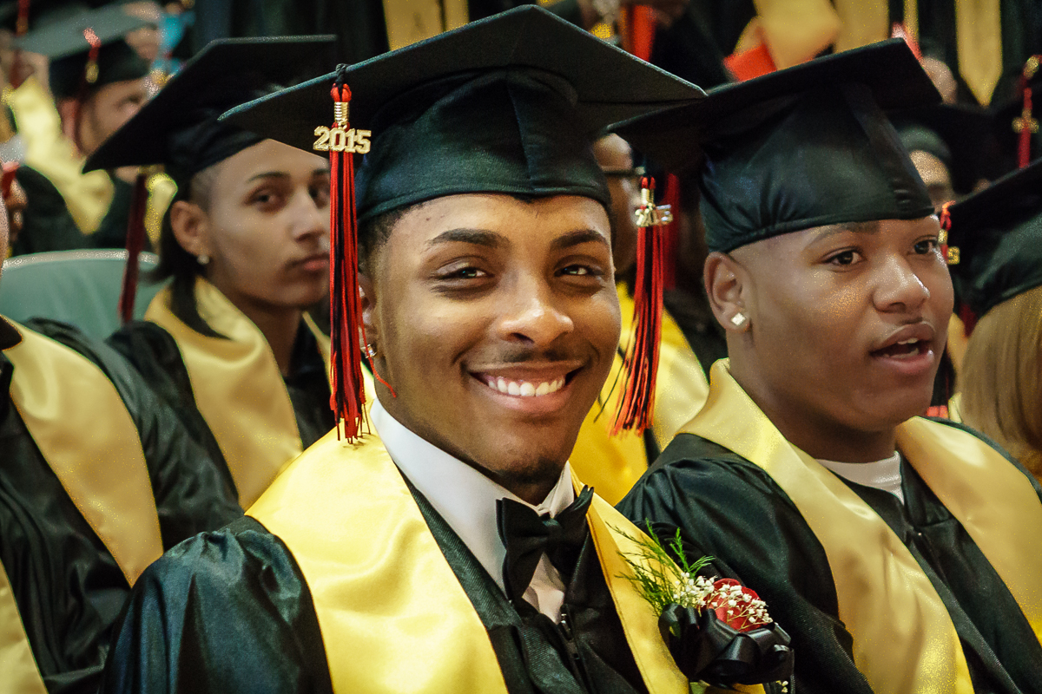
High School Renewal Results
Total College Acceptances *
  2011 – 1205
  2012 – 1508
  2013 – 1901
  2014 – 1682
  2015 - 1484
Two-year College
  2011 – 430 students
  2012 – 598 students
  2013 – 595 students
  2014 – 598 students
  2015 - 516 students
Four-year College
  2011 – 243 students
  2012 – 287 students
  2013 – 318 students
  2014 – 379 students
  2015 – 381 students
Class of 2015 students were accepted to several prestigious colleges and universities
including: Columbia University, Berklee College of Music, Howard University,
Stevens Institute, NJIT and The College of New Jersey.
* Students received acceptances to one or
more colleges/universities
38

Slide 39



Announcing District’s first
High-Performing
Rewards School
Academy of Health Science (HARP)
Attained progress targets for two consecutive years
Met criteria for all students and subgroups
39

Slide 40
Accomplishments 2014-2015
Competitive Grants Awards – Over $38 million
Award Year | Term | Title | Amount
2010 | 2011-2014 | School Improvement Grant – Schools 4 & 10 | $12,000,000.00
2014 | 2014-2017 | School Improvement Grant – Schools 6 & NRC | $12,000,000.00
2010 | 2010-2015 | US DOE Full Service Community Schools - Schools 5 & 4 | $2,300,000.00
2011 | 2011-2013 | Talent 21 grant to support technology initiatives | $2,200,000.00
2011 | 2011 | US Department of Health HRS/School Based Health Center | $ 500,000.00
2011 | 2011 & ongoing | USDA/NJDA Fresh Fruit & Vegetables Grant | $ 600,450.00 (through 2016)
2012 | 2012 | US Department of Health HRS/School Based Health Center | $ 500,000.00
2012 | 2012-2017 | 21st Century Community Learning Centers Program | $2,600,000.00
2013 | 2012-2017 | Race to The Top Phase III (Teacher and Principal Evaluation) | $1,290,000.00
2013 | 2013 | Lowe’s Community Improvement for School 4 | $ 100,000.00
2013 | 2013 | EE4NJ Pilot Program for Principal Evaluation System | $ 50,000.00
2013 | 2013 | Optimum Lightpath Grant for Panther High School & School 9 | $ 20,000.00
2014 | 2014-2017 | USDOE Turn-around School Leaders Program | $1,500,000.00
2015 | 2016-2018 | USDOE Grant for Full Service Community Schools 6 & 15 ($250k/school/year) | $2,500,000.00
2015 | 2015 | Bridging the Digital Device Gap | $ 250,000.00
2015 | 2015 | IFL Grant to work in Paterson Pre-k classrooms | $ 108,400.00
2015 | 2014-2015 | AMETEK Foundation/The SPARKS Foundation Science Explorers Grant – School 27 | $ 89,000.00
2015 | 2015 | United Way’s Paterson Reads – Schools 15 & 29 | $ 23,000.00
2015 | 2015 | USDA’s NSLP Equipment Assistance Grant (Food Services) – for 6 schools | $ 50,444.00
40

Slide 41
District Transformation Initiatives
2015- 2016
Comprehensive Assessment System | Common Core | Healthy School Culture | Capacity Building | Teacher/ Principal Evaluation | High Impact Interventions | Efficient & Responsive Operations
Star Math & ELA | Instructional Model | Effective Schools | Univ. of Pittsburgh IFL | AchieveNJ | Breakfast After the Bell | Cliff Planning
PARCC | CTE Initiative | NJPBSIS | Pre K-3 Literacy Initiative | Leadership Development Institute | RAC | Technology Initiative
Unit Assessments |  | Elementary School Choice | Urban Schools Human Capital Academy |  | End Social Promotion | Local Governance Initiative (QSAC)
 |  | Alternative Education | Strategic Data Project |  | Attendance Initiative | Image Improvement Initiative
 |  |  | Special Education Restructuring |  | Graduation Enhancement

Slide 42
Next Steps
Institute strategies to improve performance on PARCC
Continue to improve on QSAC metrics with goal of local control returned to district
Fully implement Elementary School Choice
Seek new ways to increase parent/family involvement
Continue capacity building at every level
Address attendance challenges for chronically absent children
School Facilities:
  Complete transition for two new elementary schools to open in August 2016 (School 16 and Dr. Hani Awadallah Elementary School)
  Construction will begin on a new Don Bosco Middle School in July 2016
  The newly acquired Paterson Catholic High School facility will be converted to a Paterson High School within two to three years
Continue efforts to develop existing relationships with business, community and university partners in efforts to secure third party grant funding (private, State and Federal)
42

Slide 43

“We can, whenever and wherever we choose, successfully teach all children whose schooling is of interest to us. We already know more than we need to do that. Whether or not we do it must finally depend on how we feel about the fact that we haven't so far.”
Ronald Edmonds
43

Slide 44

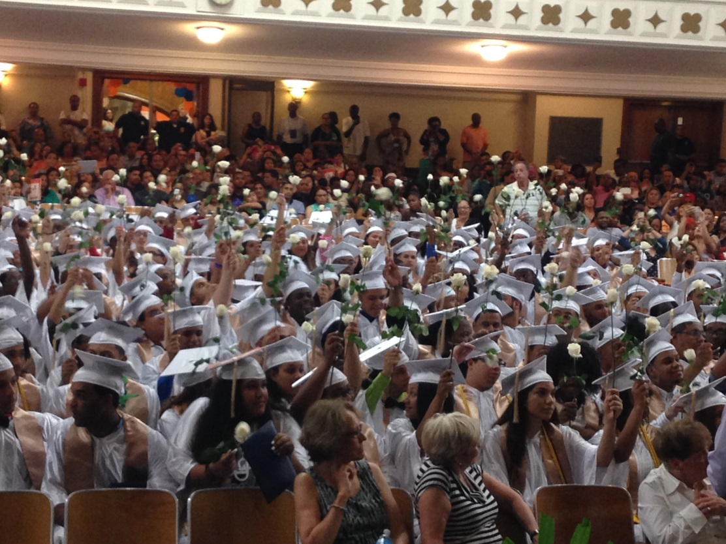
Questions
For more information, contact:
Dr. Donnie Evans – devans@paterson.k12.nj.us
Ms. Eileen Shafer – eshafer@paterson.k12.nj.us
44

